Slide 1

Balamurugan Balakreshnan(Bala)
Cloud Solution Architect

Slide 2
Career and Life
Bachelors of Engineering in Electronics and Communication - TCE
Post Graduate Diploma in Computer Application – NIIT
CSI – Executive Education – UWM
Started by Career in India for a Denim Manufacturing company
Over 22 Years Experience (20 Years in US)
Worked in Small, Medium and Large business
Worked in Manufacturing, Retail, Pharmacy/healthcare, Insurance, Automobile, Legal, Professional Services and other industries
Worked on building Digital Transformation projects
Steering committee and industry advisory board member for CSI-UW Milwaukee
Industry Advisory board member for Purdue Intelligent Manufacturing

Slide 3
Current Position (Microsoft)
Cloud Solution Architect
Digital Transformation for customers
AI/ML/DL/RL
Industrial IoT
Block Chain
AI-IoT
Cloud PaaS

Slide 4
Microsoft
At Microsoft we are dedicated to advancing human and organizational achievement.
Sustainability
Microsoft Run on Trust
Innovative
Inclusive and Diverse
Responsible AI
Our Corporate Values
Respect
Integrity
Accountability
More details: link

Slide 5
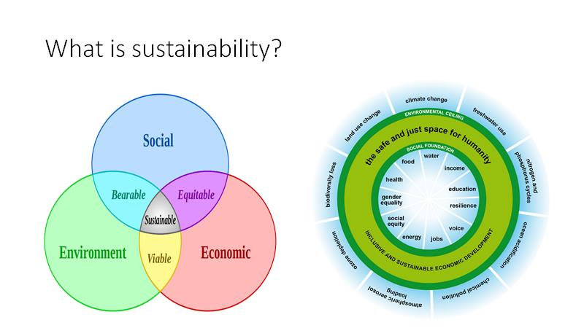

Slide 6
Jobs and Intern
Various FTE position
Technical Sales
Engineering
Marketing
Sales and more
Intern
Research
Engineering

Slide 7
Contact
Email: babal@microsoft.com
LinkedIn: Balamurugan Balakreshnan | LinkedIn
Medium: Balamurugan Balakreshnan – Medium
WebSite: My Information (balakreshnan.github.io)
Other Email: bala_b@hotmail.com

